Slide 1
MGM Resorts International : Breach
MGM Resorts International is an American global hospitality and entertainment company operating destination resorts in Las Vegas, Massachusetts, Michigan, Mississippi, Maryland, Ohio, and New Jersey, including Bellagio, Mandalay Bay, MGM Grand, and Park MGM

Slide 2
MGM Resorts International : Breach
On 11th September, 2023, news began to surface that MGM Resorts had been affected by a cybersecurity issue and its online systems were behaving erratically, causing a range of inconveniences to customers.
The online attack that disrupted MGM Resorts International resorts and casinos across the country began with a social engineering breach of the company's information technology help desk, according to a cybersecurity executive familiar with the investigation. ALPHV (aka BlackCat) is the name of the ransomware as a service (RaaS) operator who provided the threat group Scattered Spider with the malware and support services to pull off the casino cyberattacks.
In recent weeks, multiple US-based Okta customers have reported a consistent pattern of social engineering attacks against their IT service desk personnel, in which the caller's strategy was to convince service desk personnel to reset all multi-factor authentication (MFA) factors enrolled by highly privileged users. The attackers then leveraged their compromise of highly privileged Okta Super Administrator accounts to abuse legitimate identity federation features that enabled them to impersonate users within the compromised organization.
MGM shut down each and every one of their Okta Sync servers after learning that the threat actors had been lurking in their Okta Agent servers sniffing passwords of people whose passwords couldn't be cracked from their domain controller hash dumps.

Slide 3
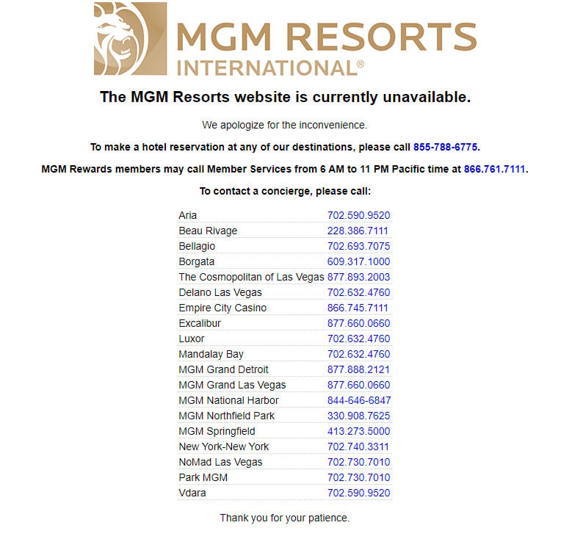
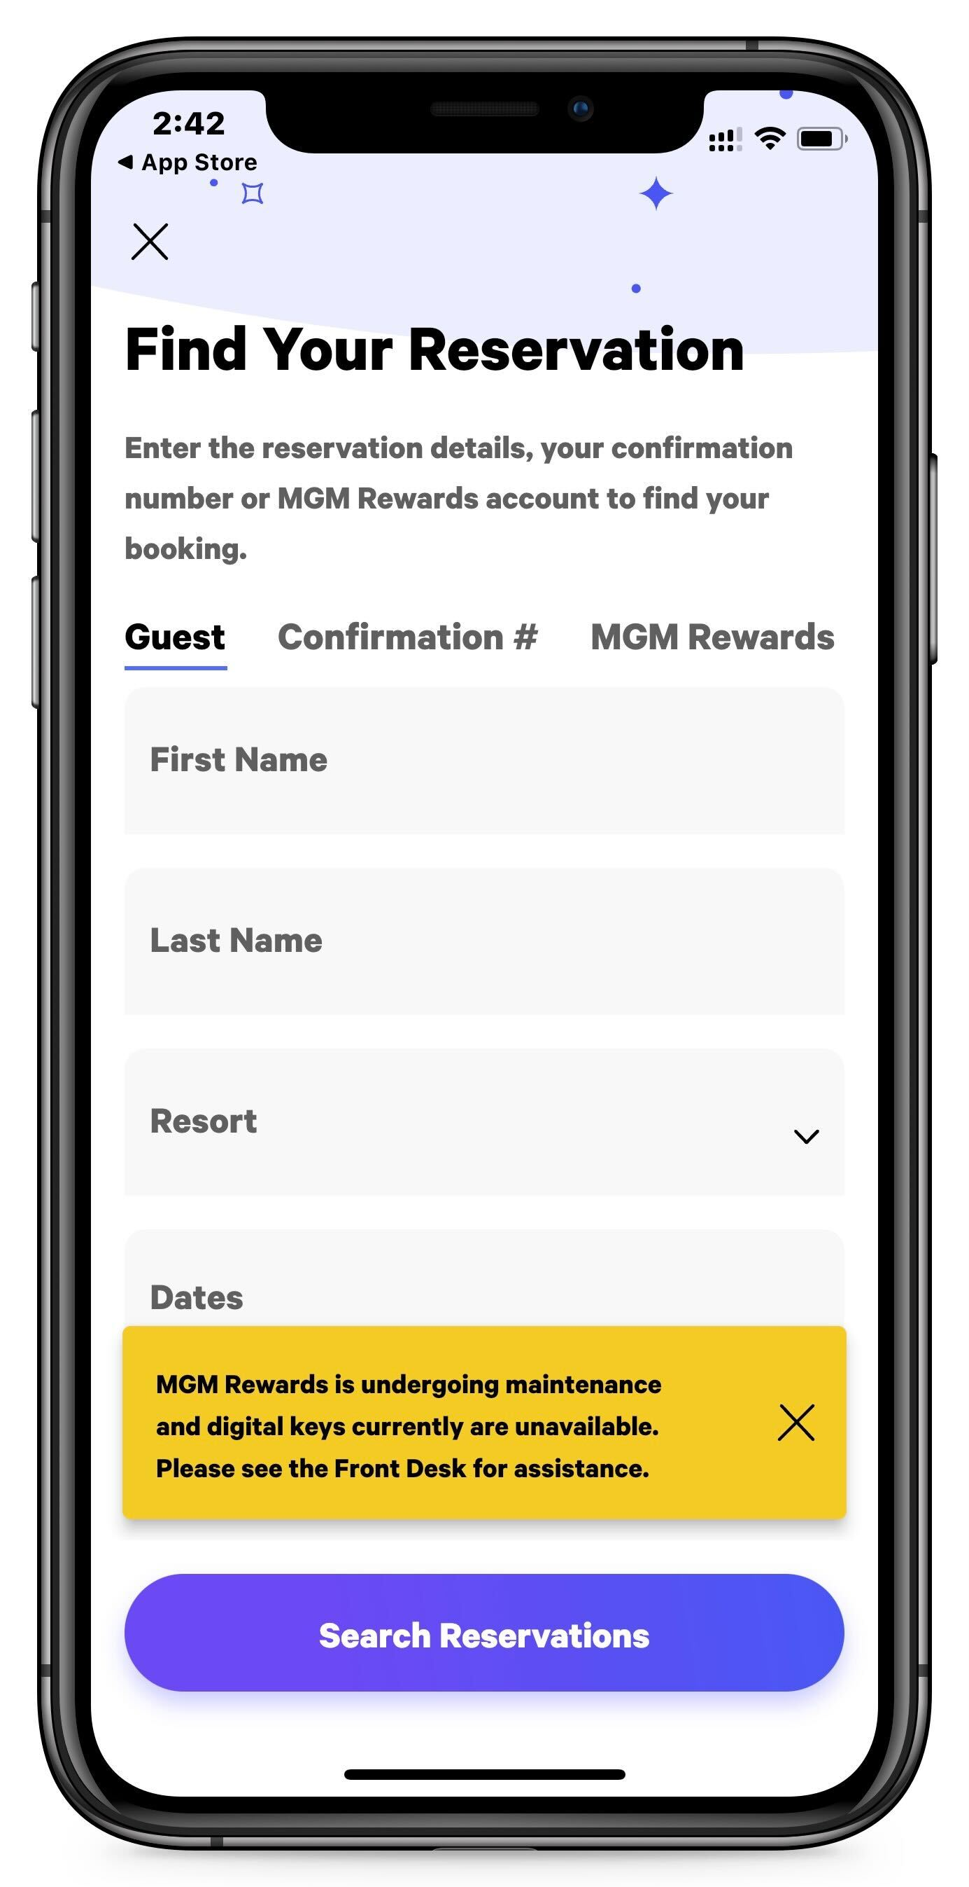
Incident : MGM shutdown computers inside their network as a response to the cyber attack.
MGM Resorts takes main website offline
MGM Rewards app offline

Slide 4
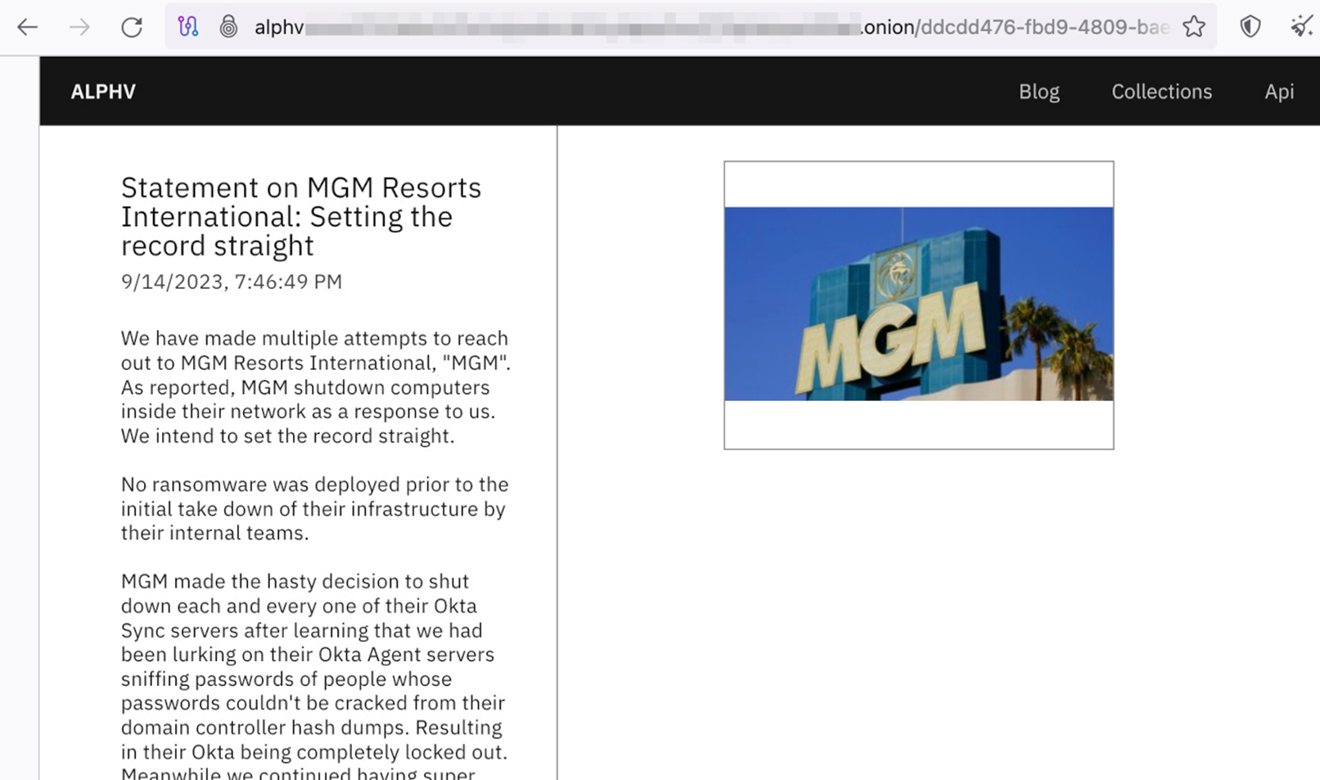
Statement on MGM Resorts International by ALPHV ransomware group
Details : https://gist.githubusercontent.com/BushidoUK/20b81335c6729dc8e0b5997ca83fa35f/raw/a0697117e905f5094e7a5feae928806b2ba65b20/gistfile1.txt

